Slide 1

NASA stuff
Ilanit Izrailov
Prakhar Saxena
Preet Patel

Slide 2
Problem Overview
Same problem, only it’s updated.
We want to extract information from the NASA’s open API.
The information about closest Asteroids/Objects to earth within the given dates/times
User is able to enter a start date and end date
User can choose to have the web app render the Astronomy Picture of the Day (APOD)

Slide 3
What We Chose to Display?
Some of the information we chose to show the users of our web app:
APOD - Astronomy Picture of the Day
NEO - Near Earth Object
Absolute Magnitude
Is the object hazardous or not?
Close Approach Date
Miss distance (km)

Slide 4
Rundown on how to use the web app
User goes into web app
Clicks on panel
User has four options to choose from:
NEO - add start and end date, then click to display info
APOD - click to display Astronomy Picture of the Day
Add NEO - user can add an object to SQL table by reference id
Added NEOs - look at updated table of objects per user

Slide 5
Used Technologies
NASA Open API
HTML
JavaScript
jQuery
SQL/MySQL

Slide 6
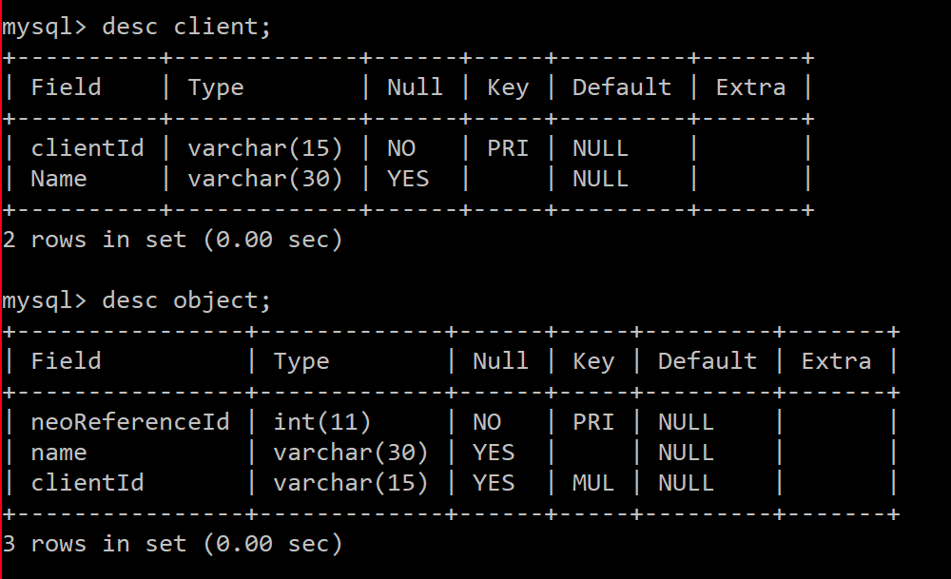
Our SQL Database

Slide 7
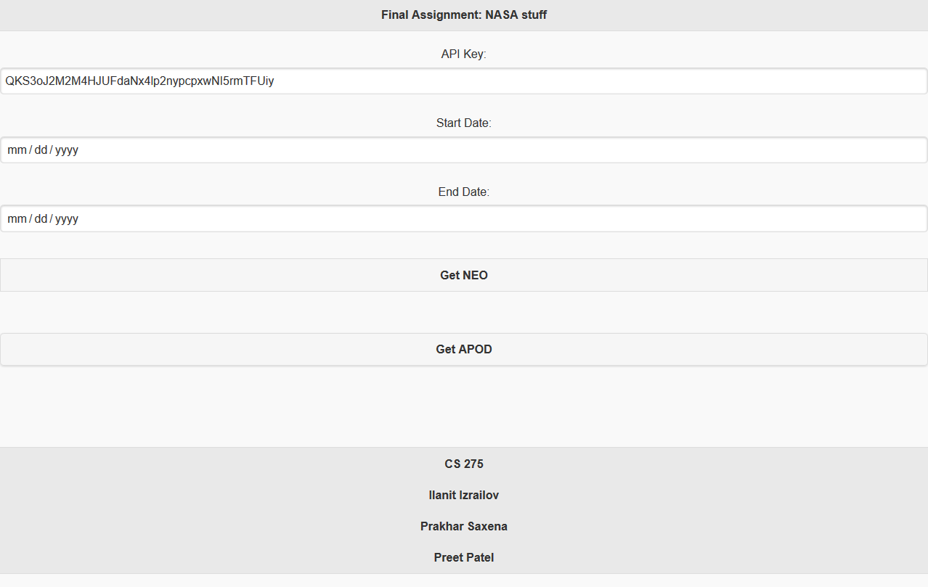
Initial Mockup of Our Web App

Slide 8
Project Demo
We will now show you a demo of our web application.

Slide 9
Thanks!

